Slide 1
Nitrogen Removal Efficiency of a Bench-scale
Moving Bed Biofilm Reactor (MBBR) Utilizing
Biodegradable Polylactic Acid (PLA) Biocarriers
Made by Additive Manufacturing
James Hayes

Slide 2
Review of Literature
In this study, a Moving Bed Biofilm Reactor (MBBR) is used to remove nitrogen from wastewater. MBBR provides a high efficiency at COD (Chemical Oxygen Demand) and TN (Total Nitrogen) removal (Ødegaard et al., 1999).
MBBR utilizes biocarriers, defined as a media support for biological agents (microorganisms in biofilm) used to remove contaminants (Yoon, 2016).
The biofilm provides both aerobic and anoxic conditions, which suits growth of both nitrifying and denitrifying microbes (He et al., 2018).

Slide 3
Review of Literature
Most biocarrier materials, such as polyethylene (PE), are relatively inert. However, some carriers can be made of biodegradable materials, which allows them to be degraded as a source of carbon by heterotrophic denitrifying bacteria (Boley et al., 2000).
Biodegradable carriers may help heterotrophic denitrification to occur when the C:N ratio is low without any extra maintenance or addition of liquid carbon sources (Zhao et al., 2017).
alleviate this problem. They may help

Slide 4
Review of Literature
It has been reported in the literature that additive manufacturing has been used to create biocarriers (Dong et al., 2015) (Elliott et al., 2017). In fact, one of the most common 3D printing filaments, polylactic acid (PLA), is biodegradable and can be used in carriers (Wu et al., 2012).

Slide 5
Hypothesis
A MBBR utilizing biodegradable polylactic acid (PLA) carriers will achieve more nitrification, denitrification, and COD removal efficiency than a reactor using K1 carriers.
Objectives
Create a biocarrier design with a high surface area using 3D modeling software.
Determine the feasibility of using PLA as a material for carriers.
Study the benefits and drawbacks of a solid insoluble carbon source to nitrification, denitrification, and COD removal efficiency.

Slide 6
Materials and Methodology
Tinkercad® software was used to design a 3D biocarrier model.
This model has a specific surface area of 1154 m²/m³.
The K1 carrier, made of PE, was used as a comparison.
Two one liter reactors were used. Reactor A utilized K1 carriers and reactor B utilized the PLA carriers designed for this study.
The specific surface area (SSA) of the individual PLA media was calculated to be 1154 m²/m³. The density of the PLA was 1.2 g/cm³.

Slide 7
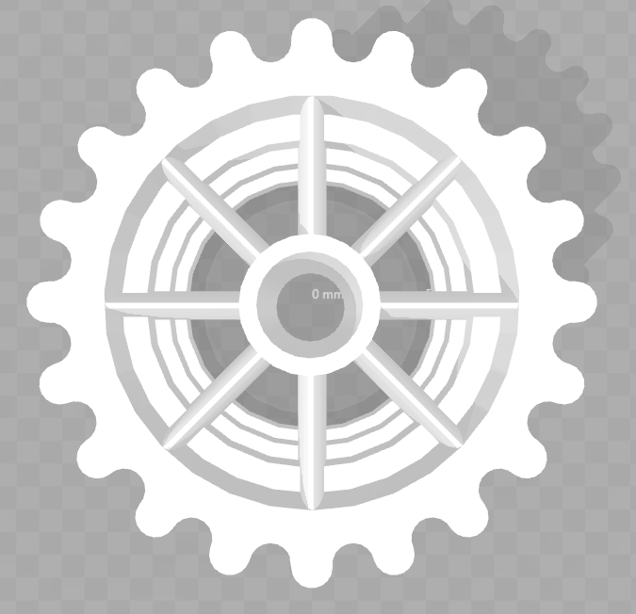
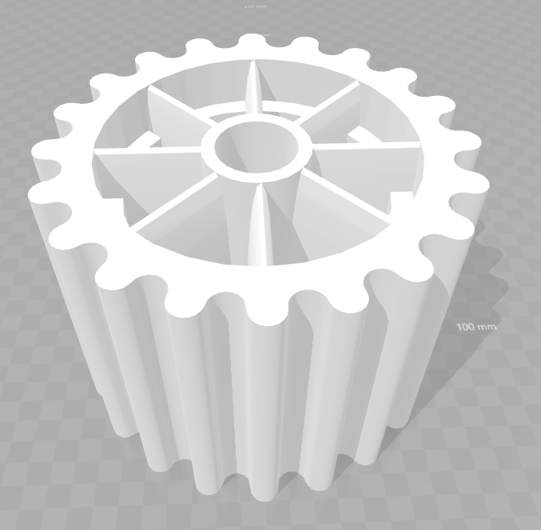
Materials and Methodology
Figure 1: The biocarrier model in an .sts file. The diameter of this model is 16mm and the height is 12mm. Three rings along the inner edge of the external cylinder are present. There is also an internal cylinder. Eight beams connect the inner cylinder to the outer one. There exists 20 ridges of the outer surface of the biocarrier in order to reduce friction and increase surface area.

Slide 8
Materials and Methodology
A modification of OECD (Organisation for Economic Co-operation and Development) artificial sewage (OECD publishing) was used as synthetic wastewater.
Oxides of nitrogen (NOx-N), COD, and ammonia (NH₃-N) concentrations in the effluent of both reactors were measured according to the procedures given by HACH testing kits (Hach Industries). pH was also measured.
The pH was measured at an average interval of every other day using a pH meter.
The carrier filling ratio (CFR) was approximately 30%.

Slide 9
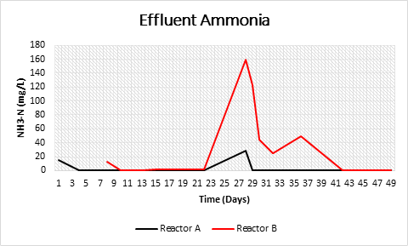
Results
Figure 2: Effluent NH₃-N concentrations in reactor A and B during operational period. Effluent ammonia concentration is displayed in milligrams of nitrogen in ammonia per liter. The average effluent NH₃-N concentration is significantly higher in reactor B (t < 0.05).

Slide 10
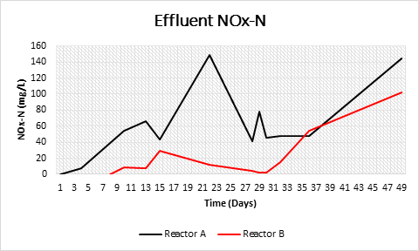
Results
Figure 3: Effluent NOx-N concentrations in reactor A and B during operational period. Effluent ammonia concentration is displayed in milligrams of nitrogen in ammonia per liter. The average effluent NOx-N concentration is significantly higher in reactor A (t < 0.05).

Slide 11
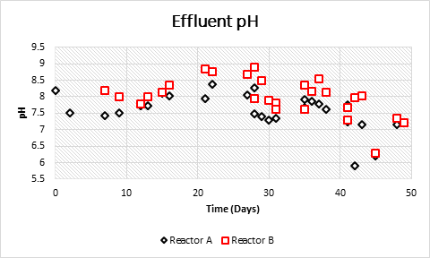
Results
Figure 4: Effluent pH in reactor A and B over operational period. The average pH in reactor B is significantly higher than in reactor A (t < 0.03).

Slide 12
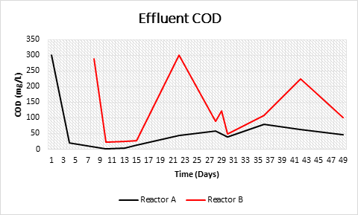
Results
Figure 5: Effluent COD concentrations in Reactor A and B over operational period. The average percent COD removal was significantly higher in reactor A (t < 0.05). The average effluent COD concentration was also lower in reactor A.

Slide 13
Discussion
The results demonstrate that little denitrification occurred in either reactor, so total nitrogen removal was negligible, but nitrification did occur in both.
The lack of denitrification could be explained by the limited time that the reactors had been running. Heterotrophic denitrifying microbes within the biofilm may not have had sufficient time to develop.

Slide 14
Discussion
The difference in nitrification rates was likely a result of several characteristics of the carriers used in this experiment. In reactor B, the high density of PLA (1.2 g/cm³) lead to negative buoyancy and a lack of movement when a biofilm was attached.
The reduced COD removal in reactor B could be explained by possibility that the heterotrophic microbes in biofilm satisfied their nutritional requirements by utilizing the carbon on which they were growing instead of organics in the wastewater.

Slide 15
Limitations
The benefits or drawbacks of biodegradable carriers could not be clearly observed due to the high density of PLA and its lack of movement within the reactor.
The reactors were run for a limited amount of time, which may not translate to extended periods used for industrial scale MBBR.

Slide 16
Future Research
Other biodegradable materials, such as PCL or PHBV, should be further investigated in regards to biocarriers, especially those materials with lower densities.
These carriers should be tested in reactors over much longer operational periods where significant denitrification might be possible.

Slide 17
Conclusions
Reactor B, which contained PLA carriers, was significantly less effective at nitrification and COD removal.
PLA is probably not an effective sole material for use in biocarriers.
This study highlights the importance of a low density for carriers.

Slide 18
Acknowledgements
I would like to thank:
My parents, my sister, and the rest of my family for their support.
Ms. Sarah Lotfikatouli and Dr. Xinwei Mao for their guidance and assistance in this project.
My research teacher Mrs. Barbara Franklin

Slide 19
Bibliography
Barwal, A., & Chaudhary, R. (2014). To study the performance of biocarriers in moving bed biofilm reactor (MBBR) technology and kinetics of biofilm for retrofitting the existing aerobic treatment systems: A review. Reviews in Environmental Science and Bio/Technology, 13(3), 285-299. doi:10.1007/s11157-014-9333-7
Boley, A., Müller, W., & Haider, G. (2000). Biodegradable polymers as solid substrate and biofilm carrier for denitrification in recirculated aquaculture systems. Aquacultural Engineering, 22(1-2), 75-85. doi:10.1016/s0144-8609(00)00033-9
Dong, Y., Fan, S., Shen, Y., Yang, J., Yan, P., Chen, Y., . . . Liu, S. (2015). A Novel Bio-carrier Fabricated Using 3D Printing Technique for Wastewater Treatment. Scientific Reports, 5(1). doi:10.1038/srep12400
Elliott, O. , Gray, S. , McClay, M. , Nassief, B. , Nunnelley, A. , Vogt, E. , Ekong, J. , Kardel, K., Khoshkhoo, A. , Proaño, G. , Blersch, D. M. and Carrano, A. L. (2017), Design and Manufacturing of High Surface Area 3D‐Printed Media for Moving Bed Bioreactors for Wastewater Treatment. Journal of Contemporary Water Research & Education, 160: 144-156.doi:10.1111/j.1936-704X.2017.03246.x
Hach Company. (2015). Nitrate, HR [PDF file]. Retrieved from https://www.hach.com/asset-get.download-en.jsa?id=7639983738
Hach Company. (2014). Oxygen Demand, Chemical [PDF file]. Retrieved from https://www.hach.com/asset-get.download.jsa?id=7639983816
Hach Company. (2017). Nitrogen, Ammonia [PDF file]. Retrieved from https://www.hach.com/asset-get.download-en.jsa?code=55835

Slide 20
He, Q., Yin, F., Li, H., Wang, Y., Xu, J., & Ai, H. (2018). Suitable flow pattern increases the removal efficiency of nitrogen in gravity sewers: A suitable anoxic and aerobic environment in biofilms. Environmental Science and Pollution Research, 25(16), 15743-15753. doi:10.1007/s11356-018-1768-x
OECD (Organisation for Economic Co-operation and Development). (2009). OECD Guidelines For the Testing of Chemicals [PDF file], OECD publishing, Paris. Retrieved from http://www.oecd.org/chemicalsafety/testing/43735667.pdf
Wu, W., Yang, F., & Yang, L. (2012). Biological denitrification with a novel biodegradable polymer as carbon source and biofilm carrier. Bioresource Technology, 118, 136-140.doi:10.1016/j.biortech.2012.04.066
Yoon, S. (2016, March 29). Biocarriers to reduce membrane fouling. Retrieved from http://onlinembr.info/fouling/biocarriers-to-reduce-membrane-fouling/
Zhao, J., Feng, L., Yang, G., Dai, J., & Mu, J. (2017). Development of simultaneous nitrification-denitrification (SND) in biofilm reactors with partially coupled a novel biodegradable carrier for nitrogen-rich water purification. Bioresource Technology, 243, 800-809. doi:10.1016/j.biortech.2017.06.127
Ødegaard, H. (1999). The Moving Bed Biofilm Reactor [PDF file]. Water Environmental Engineering and Reuse of Water, 250-305. Retrieved from https://pdfs.semanticscholar.org/6b61/ef0f8e0a1f77808633bcabe919072d84da67.pdf.
Ødegaard, H., Gisvold, B., Strickland, J. (2000). The influence of carrier size and shape in the moving bed biofilm process. Water Sci Technol 1 February 2000; 41 (4-5): 383–391. doi: 10.2166/wst.2000.0470

Slide 21
Nitrogen Removal Efficiency of a Bench-scale
Moving Bed Biofilm Reactor (MBBR) Utilizing
Biodegradable Polylactic Acid (PLA) Biocarriers
Made by Additive Manufacturing
James Hayes

